Slide 1
Image Categorization Task
Updated 7.12.25

Slide 2
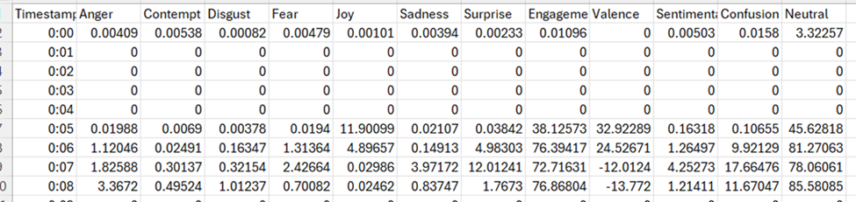
Purpose of Task
In essence, to understand we we should and should not use this data!

Slide 3
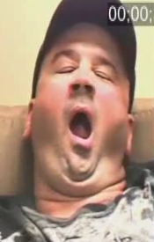
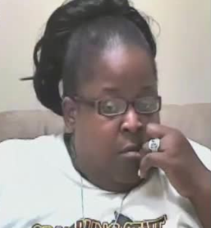
Categorizations
We will go through every image and sort them into categories that will help us decide what is usable.
Some scenarios are more worrisome than others. For example, if someone is yawning, the software, iMotions will activate fear and many other emotions. In contrast, a single muscle may be obscured, in which case the data is more likely to be okay!

Slide 4
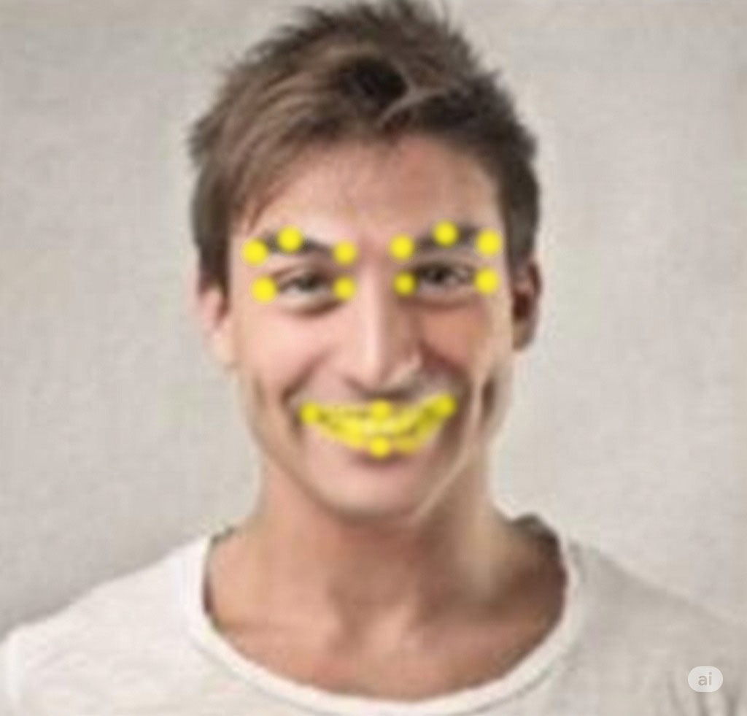
What are we looking for?
We pay attention to the following facial landmarks:
Are any of these points obscured? Are they out of the frame? If so, we categorize accordingly!
Our system captures 10 scenarios, so we number them 0-9.

Slide 5
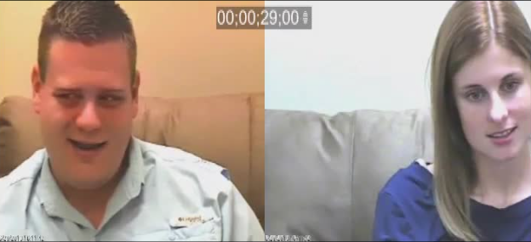
0 - The image is fine!
The categorization for images that are fine, without obstruction, yawning, etc., are 0s.
Thankfully, most images are like this, but it depends on the couple!

Slide 6
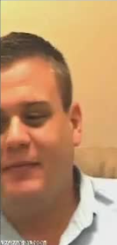
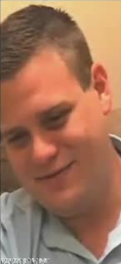

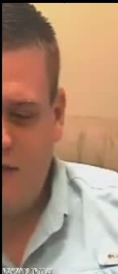
1 - Partially out of frame
How “partially” for it to be a 1?
OVER 25% of ANY landmark, but LESS THAN 50% of the total area of the face.
Most often, we are talking about eyebrows!
Clear 1
Not >25%, this is 0.
If unclear, err on side of caution. Mark a 1.
This is exactly 50%. So, not a 1… but a 2!

Slide 7
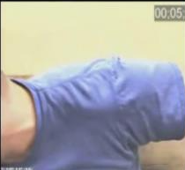
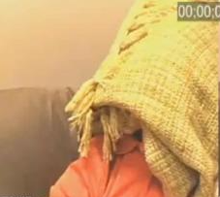
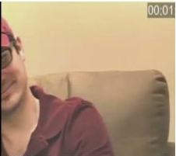
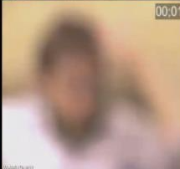
2 - Fully Covered
The face is:
OUT OF FRAME > 50%
Obscured > 50% for any reason.
This includes BLUR that is caused by the camera being out of focus.
NOT blur that is caused by movement. We don’t worry about this blur.
50% of the face refers to the surface area of the face. Not 50% of the landmarks on the face!

Slide 8
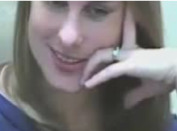
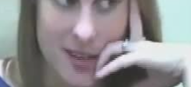
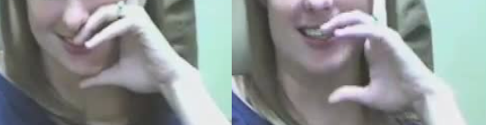
3 - Partially Covered
A landmark/muscle is covered above 25%. This is ALMOST ALWAYS an eyebrow.
For mouths, we look for over 25% of the mouth being obscured.
Still ok. Remember 25% cutoff.
Example of mouth being OK.
Mark as 3 based on mouth being partially covered!

Slide 9
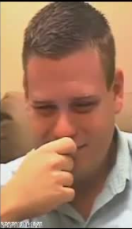
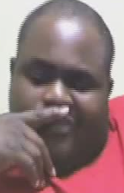
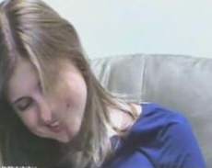
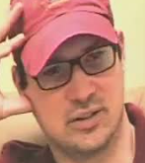
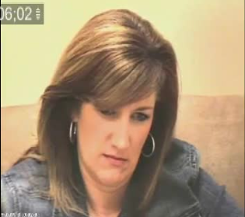
3 - Partially Covered, cont.
3s are the most common categorization you will make!

Slide 10
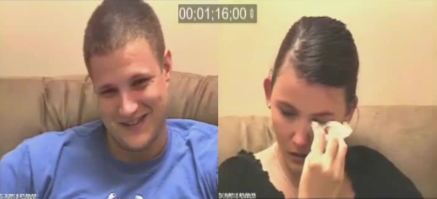
3 - Partially Covered, cont.
Things can get tricky! Remember the reference image!
Stick as closely as you can to the rules. If in doubt, do your best and flag the image. This one is one that we’d flag. It’s not super clear that any landmarks are being covered >25%

Slide 11
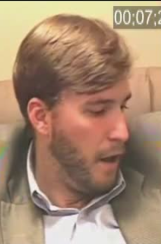
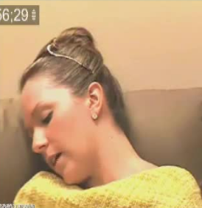
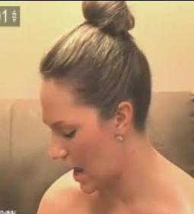
4 - Tilt
Horizontal Tilt:
If tilt is EQUAL or GREATER than 90 degrees.
In other words, you can see half the face or less!
If you can see both eyes, it’s not technically >= 90 degrees.
Can be tricky. Technically doesn’t look to be 90 degrees or more. You can see a bit more than half her face.
Clear 4.

Slide 12
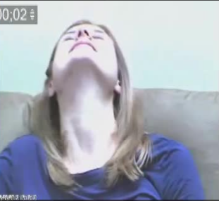
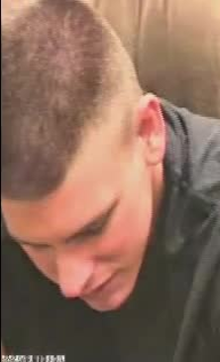
4 - Tilt, cont.
We NO LONGER categorize these as a 4. Don’t worry about vertical tilt.
However, if it’s very dramatic, as in the images on the right, you can FLAG it and leave an image note.

Slide 13
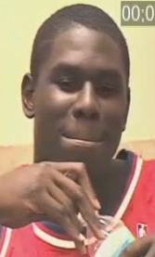
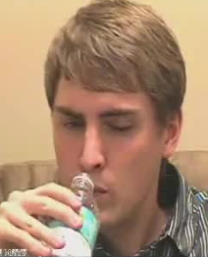
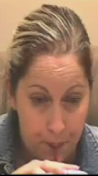
5 - Drinking
NOTE: After people drink, they often adjust their mouth for a few seconds - mark these frames as 5 until they return to normal!
Easy 5s.

Slide 14
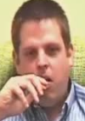
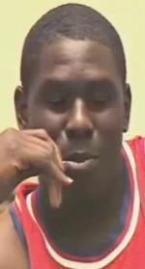
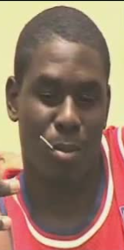
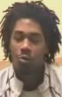
6 - Eating
Mark as 6 if:
They are actively chewing something!
Their mouth is different because they’re about to eat
You’ll want to watch the VIDEO to see which frames these are.
Unclear, watch video!

Slide 15
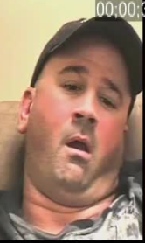
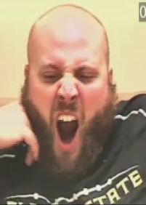
7 - Yawning
Self-explanatory! Remember that it is a 7 until they are back to normal.

Slide 16
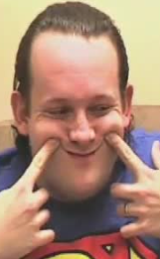
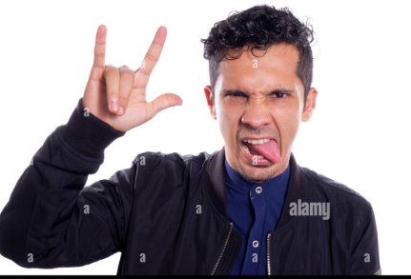
8 - Weird Face!
These are instances where the person is making an expression that is unlikely to be related to the emotion they’re actually expressing.

Slide 17
9 - Video ends prematurely
Sometimes the screen might go black before the full end of the video.
Mark the FIRST black frame on both sides and that’s it. Only the first.
Example: the video shows that frames 470 - 480 are black. For frame 470, left and right should be categorized a 9!

Slide 18
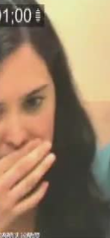
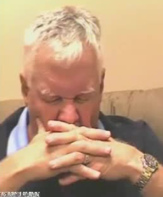
What if multiple categories are applicable?
The following is a helpful way to think about it. Some categorizations are more severe than others:
0 -> These are good to use!
1, 3, 4 -> These are relatively ambiguous.
2, 5, 6, 7, 8, 9 -> These are severe. We likely won’t include this data in our analyses.
If 3 and 5 are applicable at the SAME time, we categorize it a 5, because 5s are worse than 3s.
<- 7s are worse than 3s! This is a 7.
1s are (generally) worse than 3s! This is a 1. ->

Slide 19
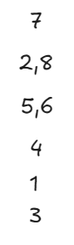
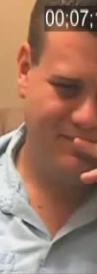
What if multiple categories are applicable?
For reference, this is the hierarchy.
Worst is 7 - it overrides everything. If a person is yawning while it’s a 2, 3, etc. mark it a 7.
2 and 8 are nearly as bad. If it’s a 2/8 while also a 3, 4, 5, 6, etc. mark it a 2/8. (2 while also an 8 seems impossible)
5/6 are bad. They override things like 1, 3, and 4. If a person is eating with their head tilted or partially out of frame, for example, what’s worse is that they’re eating/drinking! So, 5s and 6s override these.
4 overrides 3 and 1.
1 overrides 3.
<- 1 and 3. This is a 1.

Slide 20
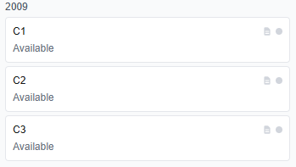
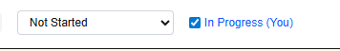
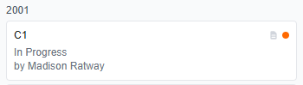
The Platform
Select conversations that are available - no one has done even a first pass! These show up as “Available”.
Once you’ve decided to do a conversation, enter it and mark it as “in progress”:
Now it shows up like this and two people shouldn’t work on it at the same time.

Slide 21
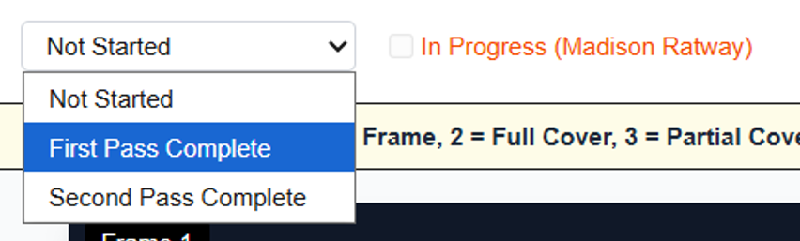
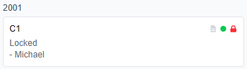
Completion Status
Mark conversations a first pass complete when you’re the first person to have gone through the whole conversation. Remember to remove the “In Progress”!
At some point, some of you will do second passes, going over EXISTING categorizations and ensuring they are correct.
Eventually, I will be doing passes of double checked conversations and “locking” these conversations to finalize the categorizations.

Slide 22
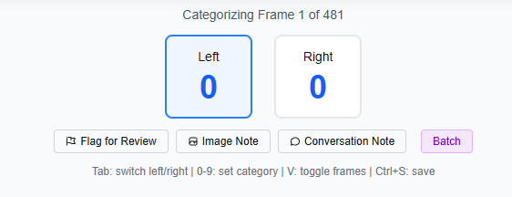
Procedure
Do ONE person at a time! Meaning, do a run-through of the person on the left and THEN of the person on the right.
Flag for Review:
If you are REALLY unsure of what to categorize an image… give it your best guess and flag it.
You probably want to email me in the beginning to make sure you’re not over-flagging things that should be categorized in a certain way. You should leave a note for the image explaining why you flagged it.

Slide 23
Procedure
You can leave notes at the image level and the conversation level. These are meant for scenarios where things are odd for some reason, and I would benefit from further context.
For example, if a person has a hat that completely covers half the person’s face for the whole conversation, then it’s a good idea to note this in a “Conversation Note” which is tied to the conversation as a whole.

Slide 24
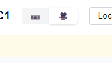
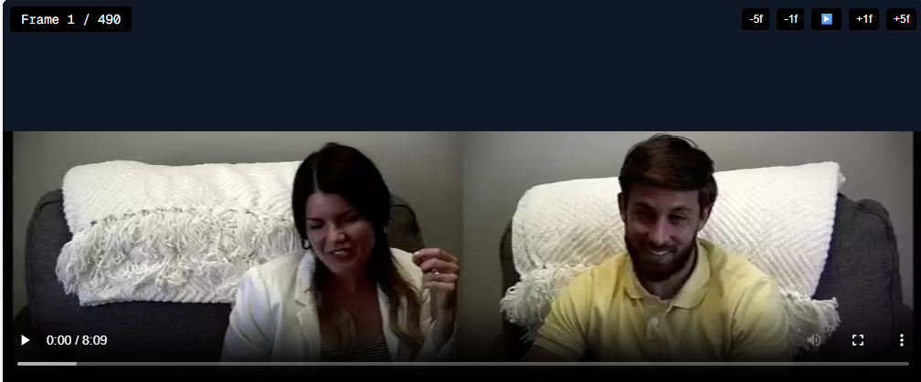
Procedure, cont.
A few additional notes:
For conversations where people seem to be eating, you can toggle to watching the video by clicking that. Use this when people are eating, as it’s hard to tell chewing from still images.
Note that the video was heavily compressed and lacks audio for storage space purposes!

Slide 25
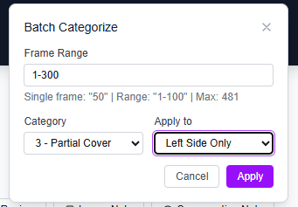
Procedure, cont.
Occasionally, you will want to categorize many images at the same time.
For example, a person on the left side is wearing a hat for the first 5 minutes of the video such that it covers both eyebrows!
You check that there are not instances of multiple categorizations applicable at the same time, and want to categorize frames 1-300.
This is what the purple “Batch” button is for.

Slide 26

Remember
MAKE SURE YOU SAVE YOUR WORK once in a while and before you leave the page!
Remember to mark conversations as complete when you are done.
You can download these slides from the platform by clicking this button:

